Slide 1
The Forge
Senior Project
By
Bryan Denslow

Slide 2
What is The Forge
The Forge is a website to help facilitate agile project development among a team.

Slide 3
Why Create The Forge
http://rebel-outpost.com/ needed a Tool to develop Ruby on Rails projects using an Agile Methodology.
http://rebel-outpost.com/ was using http://www.pivotaltracker.com/ which is very expensive.
Learn Ruby on Rails. (My Very First Rails Project when I started Web Development)

Slide 4
How does it Work?
A Project has certain big tasks that need to be done. These are called Epics. Example: Create a Login System, User Dashboard

Slide 5
How Does it Work? (Cont)
Each Epic has certain tasks that need to be done before the epic is completed. Example, Epic: Login: Task1: Create Users, Task2: Login with Google, Task3: Login with Twitter

Slide 6
How does it Work? (Cont)
Each task can be started, completed, delivered, and accepted. Also each task can have comments on them.

Slide 7
How Does it Work? (Cont)
Projects can have multiple users. Anyone who is on the project can add or remove people.
There is no level of rights for a project. A user either has full access to a project or none at all.

Slide 8
Tools Used for the Project
Ruby on Rails (Framework)
Mongodb (Database)
Rspec (Testing Framework)
Haml (Html Markup Language)
Metro UI (Windows 8 Metro Styling)

Slide 9
Ruby on Rails
Ruby on Rails is an open source web framework that is optimized for programmer happiness and sustainability. It lets you write beautiful code by favoring convention over configuration. - http://rubyonrails.org/

Slide 10
MongoDB
MongoDB (from "humongous") is an open source document database, and the leading NoSQL database. Written in C++, MongoDB features: Document-Oriented Storage, Querying, Map Reduce and many more. - http://www.mongodb.org/

Slide 11
Rspec
RSpec is testing tool for the Ruby programming language. Born under the banner of Behaviour-Driven Development, it is designed to make Test-Driven Development a productive and enjoyable experience. - http://rspec.info/

Slide 12
Haml
Haml is a markup language for html
Haml (HTML abstraction markup language) is based on one primary principle: markup should be beautiful. It’s not just beauty for beauty’s sake either; Haml accelerates and simplifies template creation down to veritable haiku. -http://haml.info/

Slide 13
Metro UI
Metro UI CSS allows to create a Web site in the style of Windows 8 quickly and without distractions on routine tasks -http://metroui.org.ua/

Slide 14
Metro UI (Cont)
I highly recommend The Metro UI. It is extremely easy to use and looks well. Also it dynamically scales for mobile devices. All you have to do is include the CSS!

Slide 15
Test Driven Development
I used an Agile Test Driven Development Method.
I would write tests before developing and then make then pass. This I found really helps make clear in my mind what I am supposed to do before I even code it. Also this also ensures that one never loses functionality in a project.

Slide 16
Ruby on Rails MVC
Rails is really awesome and would be fun for a higher level CS Course
Why? Because it teaches about the Model View Controller structure. Also because many more website projects are using rails.

Slide 17
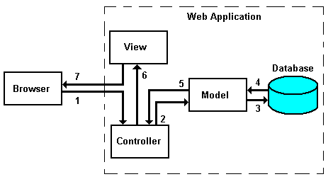
Ruby on Rails MVC (Cont)

Slide 18
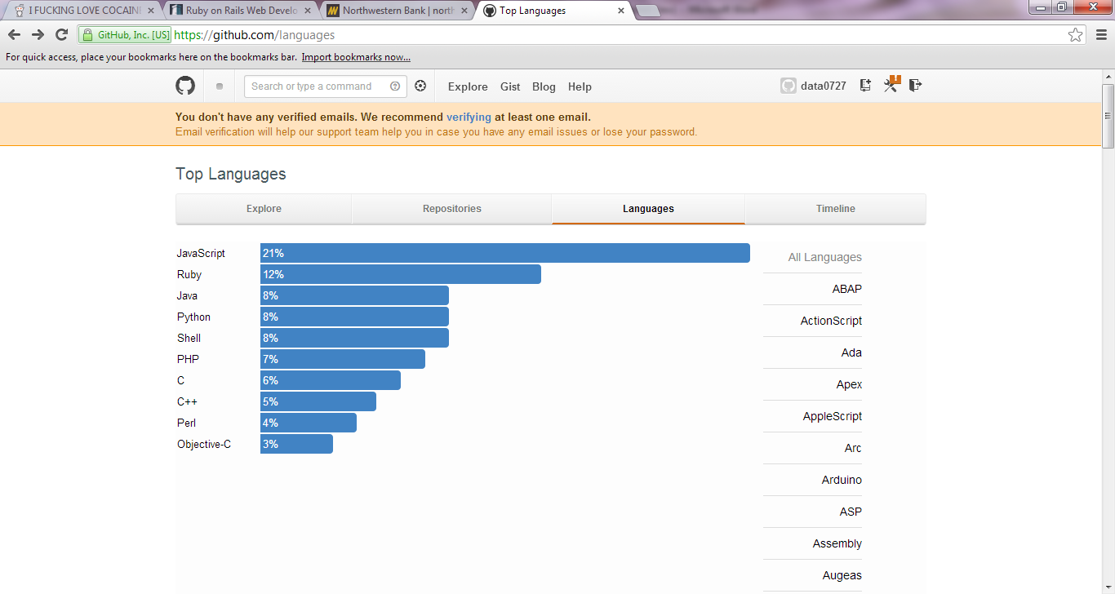
Ruby on Rails MVC (Cont)

Slide 19
Ruby on Rails MVC (Cont)
Github, the most hosted projects are Ruby and Javascript. This is where the industry is heading. I would highly suggest classes on advanced javascript or rails.

Slide 20
This has been a Great 4 years
Thank all of you for training me into the programmer that I am today.
Because of your hard work I already have a job working at Mecosta County Medical Center doing IT work.
Also because I was able to get a job, I am getting married on July 27th of this summer.

Slide 21
Questions?
Complimentary Batman vs Superman?
Batman always wins!

Slide 22
Grading Scale
Grading Scale
Login with Facebook = 3 points /completed
Login with Google = 3 points /complted
CRUD (Create, Edit, Update, Delete) multiple projects = 5 points / completed
Multiple Users Can Be Added To A Project = 10 points /complted
CRUD Epics = 5 points /completed
CRUD Tasks = 5 points /completed
Users that are on a project can write comments on a task. = 3 points /completed
Tasks can be ‘Started’, ‘Completed’ , and ‘Accepted’ = 3 points /completed
Hosted online = 5 points /completed
Project Velocity = 10 points /completed
Looks aesthetically pleasing = 5 points. /completed (Up to interpretation)
Total = 57 points/57points
Grades with Point Value
A = 52
B = 40
C = 30
D = 20

