Slide 1
String Master Android App
Cody Malnor
Winter 2018

Slide 2
App Overview
Trainer
Help user memorize where notes are on the guitar fretboard
Accomplished through a time based game
Different settings can be applied to learn parts of the fretboard
Guitar tuner
Functions like a standard guitar tuner
Senses nearest note
Settings
Options to change the behavior of the trainer
Number of frets to test
Game length
Include sharp/flat notes
Clear high scores

Slide 3
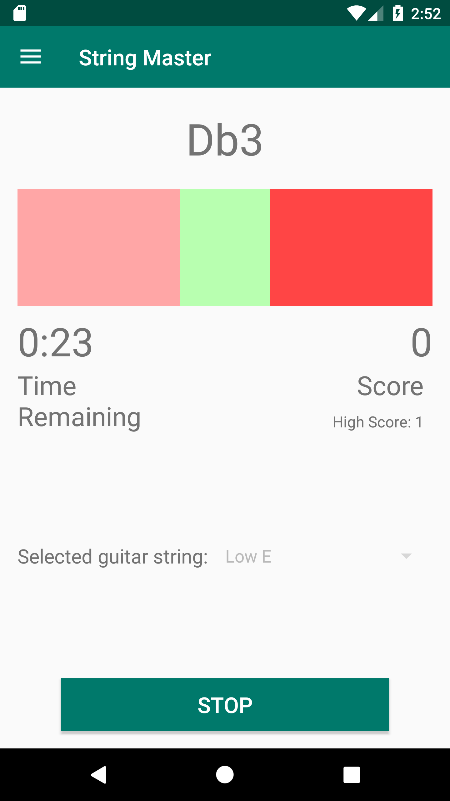
Trainer
Current note to play
Access navigation bar
Pitch correct indicator
Pitch low indicator
Pitch high indicator
Time remaining in game
Score for the current game
High score for selected
combination of settings
Select string to test
‘Start’, ‘Stop’, ‘Reset’ button

Slide 4
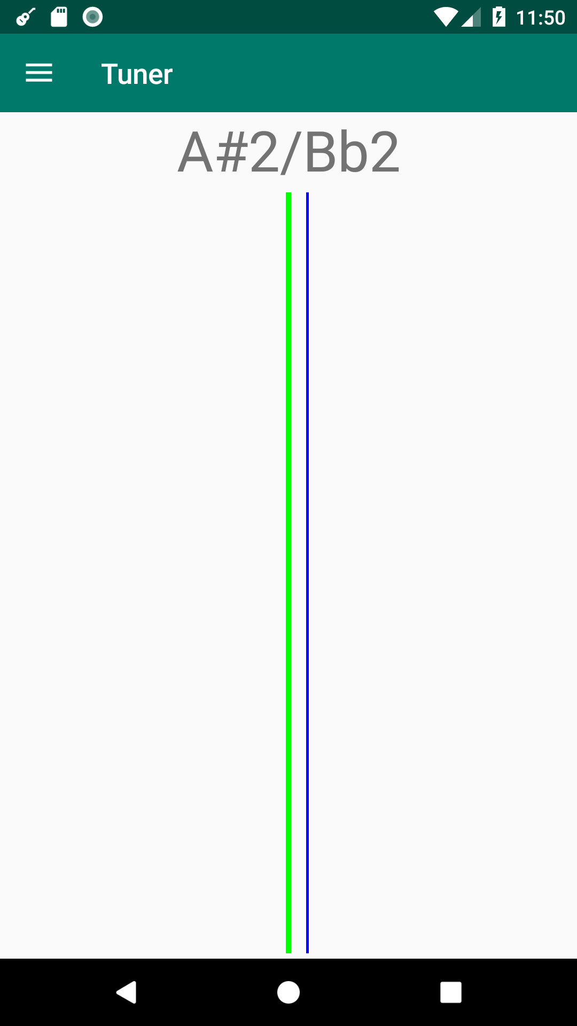
Tuner
Access navigation bar
Closest note to user pitch
Exact note pitch
User pitch

Slide 5
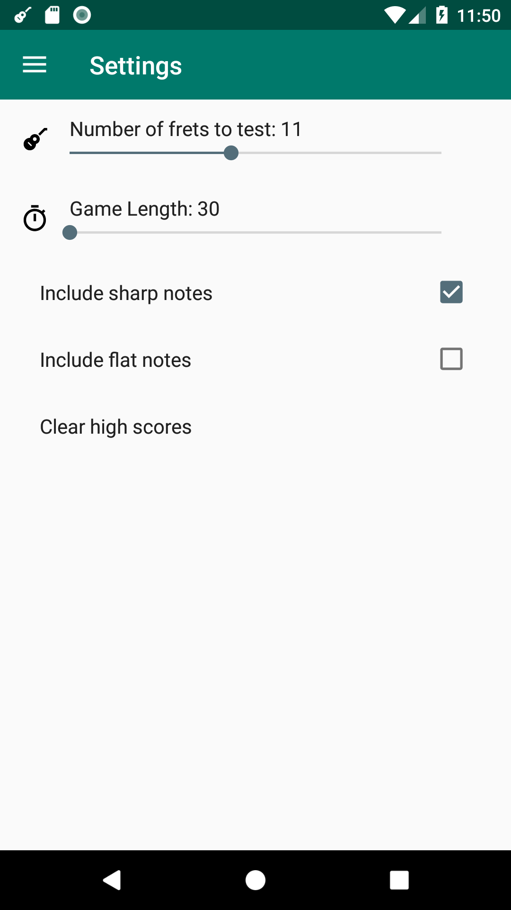
Settings
Access navigation bar
How many frets of notes
will be tested in trainer
Include sharp notes in
trainer
Length of trainer game
Include flat notes in
trainer
Open dialog to confirm
erasing high scores

Slide 6
App Demo

Slide 7
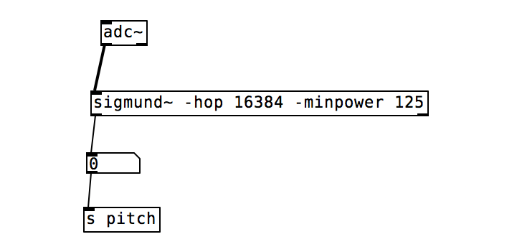
Reading Notes From Guitar
Create Pure Data patch
Request permission to use the microphone
Create service which uses a Pure Data Patch

Slide 8
Grading
 | Points earned | Points possible
Sound | 38 | 40
Record and filter sound | 18 | 20
Convert sound to MIDI | 5 | 5
Note detection | 15 | 15
Trainer | 38 | 40
Note randomizer | 5 | 5
GUI | 13 | 15
Metrics | 10 | 10
Game logic | 10 | 10
Tuner | 8 | 10
GUI | 8 | 10
Navigation Drawer | 10 | 10
Notifications | 10 | 10
Total | 104 | 110

Slide 9
Extra Points
 | Points earned | Points possible
Settings | 15 | 15
Proposed Total | 119 | 125

Slide 10
FAQ
How many lines of code?
Java: ~1600 w/comments
XML: ~400
Did I have prior experience with this subject?
About 3 weeks of experience in Andy’s Android class
Learned Java through schoolwork
What would I do differently?
Kotlin
Begin with ConstraintLayout

