Slide 1
Discord Bot Senior Project
By: Dan Krueger

Slide 2
Discord
Released two years ago
Designed to be used by gamers
Over 45 million users
Written in JavaScript and HTML
Notes:
So for anyone that does not know what discord is, it is a program that’s really similar to skype. Skype, as far as I am aware, you still need to call someone or be called. That means if you are in the middle of doing something like playing a game, you need to stop what you are doing, go to skype, answer the call, and then go back to what you were doing. Discord is different from that because it was designed for gamers. If you are playing a game, it is obnoxious to stop what you are doing to call someone just so you can talk. In discord, there is just open channels in your server 24/7. Once you are part of a server, or make your own, you can join the voice channel before you start doing anything. Then if someone comes online, they can join the same channel as you and no one has to call anyone. There is now about 45 million people that use discord because of the features that it has, and how easy it is to use.

Slide 3
Why I choose JavaScript?
Discord is made in JavaScript, and the developers of discord made a discord.js package that you can download and import. With that, you are able to sync your JavaScript code with a discord bot that you created and got a token for.
https://discordapp.com/developers/applications/me
Once you get your token and learn how to use discord.js, you can make the bot do almost anything you can imagine.
Notes:
Using JavaScript, there are more modules than you would ever really need. I use about 3 or 4, mainly ones related to YouTube, but there are modules for imgur, google, and basically every really popular website. Using these modules lets you get information from these websites, and then using discord.js you can actually display/play this information in discord for all the people to see/hear.
I chose JavaScript because discord is written mainly in JavaScript, but also HTML because if you do not download the discord application, you can still connect to channels and talk to people using the website on a browser. They made a discord.js package that you can import and use with JavaScript to create bots for discord. Learning how to use discord.js was a little tricky because I wasn’t super confident even coding in JavaScript yet. I only had one course on JavaScript, and it was not even for the full semester, we just learned the basics. So I had to teach myself how to code in JavaScript, which wasn’t too bad, and then how to add the discord.js stuff into that.
The people that made discord also host their own discord server where you can go if you have any questions. I posted a couple questions in there when I was still learning how to even get started with this project, and every time they pointed me in the right direction to get the problem solved. If it’s a simple question they can answer it right on the spot, but if it’s a more complicated or detailed question they tend to point you in the right direction or tell you what resources to look up to solve the problem on your own, which is awesome. When I posted my question in there I didn’t want someone just giving me a chunk of code saying that it works, but I wanted to learn how to do those things myself, which is exactly what they did.
In JavaScript there seems to be modules for everything. I mainly used YouTube modules to do what I had to do, but I plan to add more features to this bot and I will end up using a lot more of the available modules.
So to start making discord bot, you have to go onto the discord developer website and generate an App. With that app, you get a token and you add that token to your JavaScript code so the app knows what to do. Once you generate your app, get your token, and ID you can add the bot to your server. Once it’s added to your server, you can include it in your JavaScript code, and make the bot do basically whatever you can imagine with JavaScript.

Slide 4
What my bot does with YouTube
Plays the YouTube song given a specific link
https://www.youtube.com/watch?v=1vrEljMfXYo
Looks up a song given a tittle, and grabs the number 1 result.
country roads take me home
Will add an entire YouTube playlist to the song queue given a link
https://www.youtube.com/playlist?list=PLmlQVmIs866w2vx6qP7FW98hjrm2ho2G-
Can create custom playlists stored as text files
Notes:
It uses 2 YouTube modules. One will play the link If you give it a YouTube link to a song. The other will look up that title on youtube, and once it finds the results, it takes the number 1 result and gets the information on it, including the link. Once I have the link I then pass that link to the first YouTube module and it will get the song and play the stream into the discord channel.

Slide 5
Technologies
Discord.js
Ytdl-core
YouTube module to download YouTube songs given a link
Simple-YouTube-API
Gets results from YouTube, and gets songs from a YouTube playlists, and generates links
Google-API-Key
Allows the YouTube module to get songs and play them in discord.
Notes:
For the YouTube modules, I used two different ones. The first one was Ytdl-core. I read a lot about that online, but not much was very helpful. People basically were just saying use the module, but not saying how to. Finally, after looking forever I found someone that actually showed how to use it, and it’s really straightforward. This module just needs a direct link to a song on YouTube and it is able to get the stream of music, which you can then use JavaScript to play through the bot.
The other YouTube module I used was really cool. If you give it a string of words, it will grab the results on YouTube for what you entered. Once you have the result that you want, you can get all the information on it, including its ID, which is the last part of the YouTube link on songs. With that ID, you can add on the rest of the generic YouTube link and give that to the first YouTube module, which will then get the song for you. The module also has a cool feature with YouTube playlists. If you see that it’s a playlist, you can use one of its features to walk through the playlist. When walking through the playlist it does the same thing, grabbing all the ID’s. You can then queue up all the songs one at a time, and then the queue on discord will be the same playlist. So if you wanted, you could make a playlist on YouTube and whenever you connect to discord just tell discord to queue it up.

Slide 6
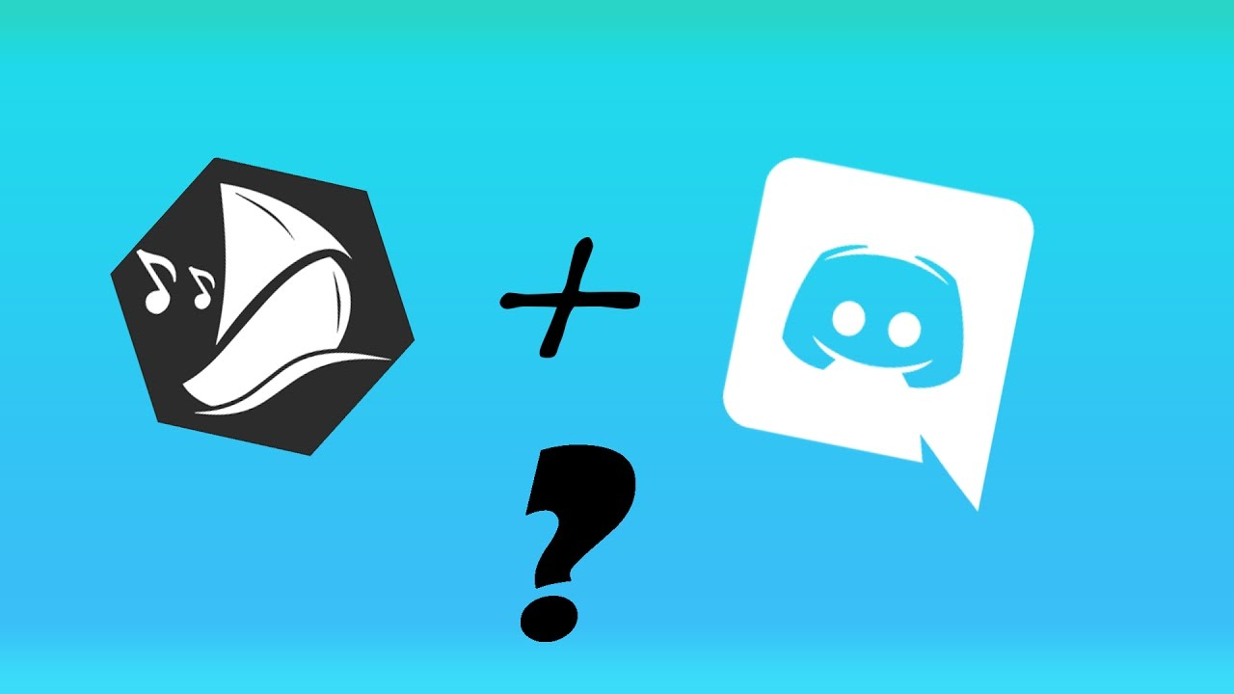
Other bots
Why I decided to make my own
FredBoat
https://fredboat.com/
https://discordbots.org/
Notes:
There are tons of discord bots out there. One of the most popular bots is called FredBoat. You can go to their website and add the bot directly to your server, which is really cool. The downside of that, is that you have to select what song you want out of the top five. It’s a really cool feature, but it involves more time typing and selecting songs than really necessary because almost all of the time you look something up on YouTube that’s a song, the first result is going to be what you were looking for. It happened a few times where me and one of my friends were playing a game, and in the 5 seconds or so we had between rounds we tried to queue up a song forgetting that you had to enter the song, wait for the list, then almost always say to play the first one. So that’s the main reason I decided against implementing the list of options myself, cause there so far hasn’t been once the first result is wrong, and it’s a lot faster to just assume the first is correct.

Slide 7
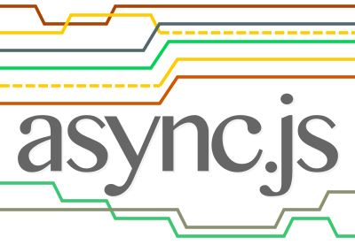
What I learned
JavaScript!
Error Checking……everywhere
Using async functions
Notes:
Before this senior project I didn’t have too much exposure to JavaScript. This semester I also had client side web programming, which I learned a lot of JavaScript in also, which definitely helped. After my project and client side I can comfortably say that I know JavaScript pretty well. Another thing I got much better at is error checking. In the beginning I was pumping out working code, but not thinking about all the cases that COULD happen, even if they were unlikely. After crashing my program a few times, I went back, added error checking, and the rest of the code I wrote I included lots of error checking write away to prevent any issues, which seems to have worked. I tried as many cases as I could, entering commands in every order, and the bot handled them all as it should’ve. Async functions is something I had no experience with at all before my senior project. I looked up a lot about it, but it’s a confusing concept in JavaScript because it returns a promise. I’m still not 100% comfortable with promises in JavaScript, but I’m close to understanding them very well.

Slide 8
Points
Project Goals
(5 points) Be able to display pictures based on the keyword entered.
(5 points) Be able to keep a log of all commands entered for the bot to compute.
(10 points) Be able to play the number one result on YouTube when the play song command is entered.
(2 points) Be able to replay songs.
(5 points) Have an adjustable master volume.
(10 points) Be able to create customizable playlists and then play them on command.
(3 points) Be able to delete messages in the channel you type the delete command.
(3 points) Display the fact of the day when asked to do so.
(7 points) Be able to enable/disable features by entering a command.
Total Points : 40/50
Grading Scale
45-35 Points = A
34-30 Points = B
29-25 Points = C
Below 25 = Fail
Notes:
Lots of little details weren’t included in this. For one of the goals, I said play the number one result on YouTube. That doesn’t explicitly say to add a queue, be able to skip, pause, resume, etc. but its stuff I kind of thought went with it, cause if you could only play one song at a time and need to wait until its over to start another one that would suck. Other than that I got most of what I wanted, but I actually plan on periodically adding more features to this to make it even better.

