Slide 1
Through the Digital Looking Glass: Augmented Reality and its applications
By: David Pfeiffer

Slide 2
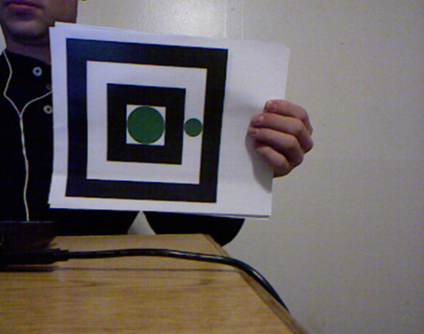
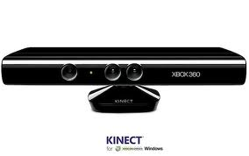
What is AR?
The interaction of superimposed graphics, audio and other sense enhancements over a real-world environment that’s displayed in real-time.

Slide 3
TOOLS
Marker
Camera
Display
OpenCV
PCL

Slide 4
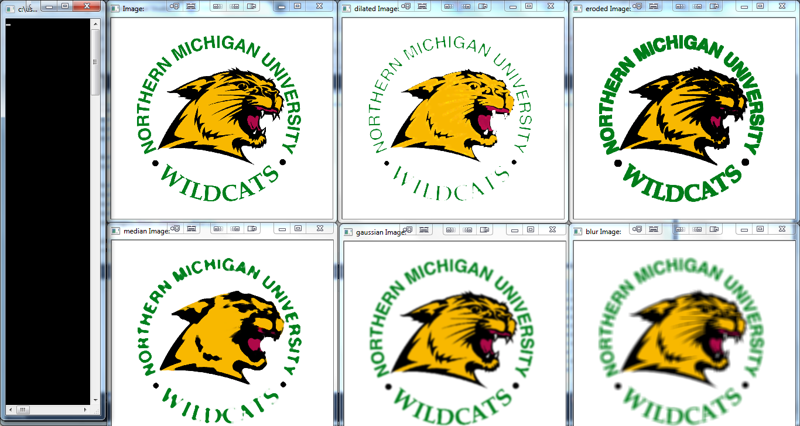
Image Filters
Erode
Dilate
Median
Gaussian
blur

Slide 5
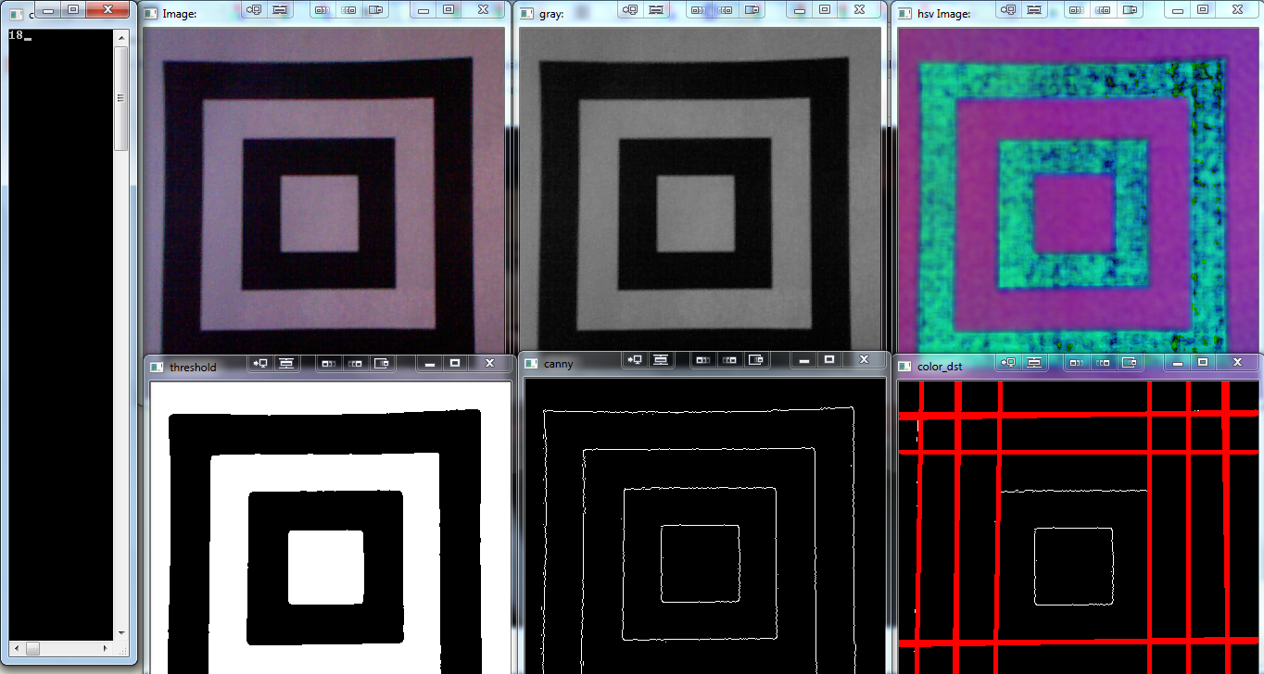
Feature Detection
cvtRGB2GRAY
cvtRGB2HSV
Threshold
Canny
Hough Lines

Slide 6
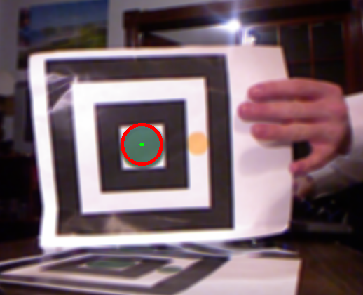
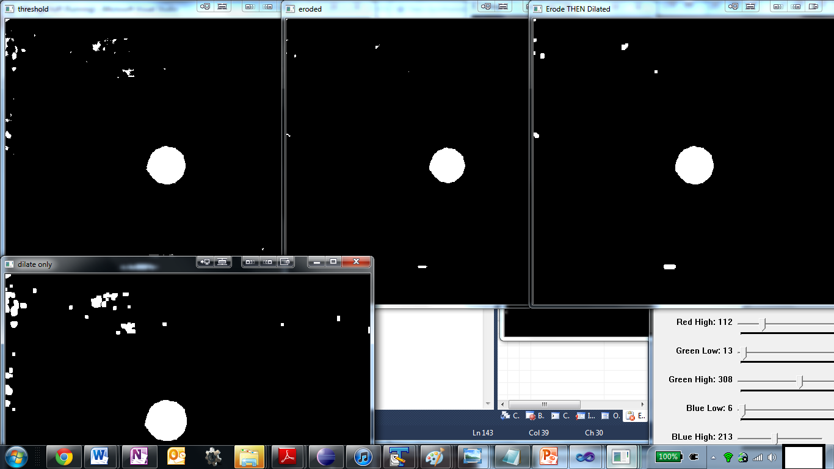
Circle Detection
Work with threshold
Erode Then Dilate
Inconsistent

Slide 7
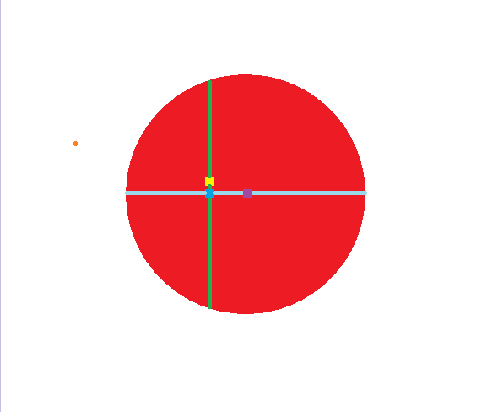
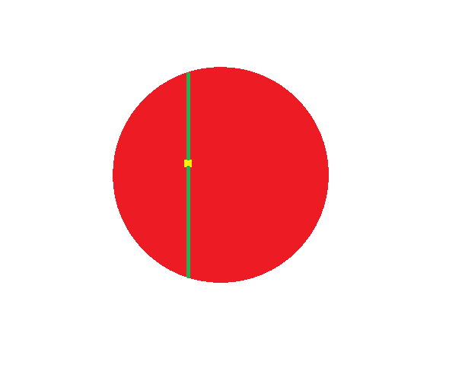

Slide 8
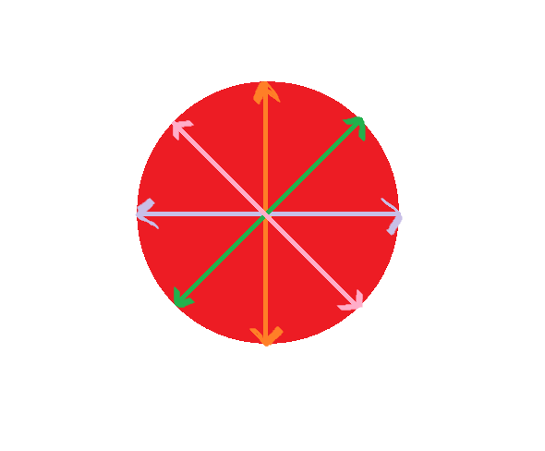

Slide 9
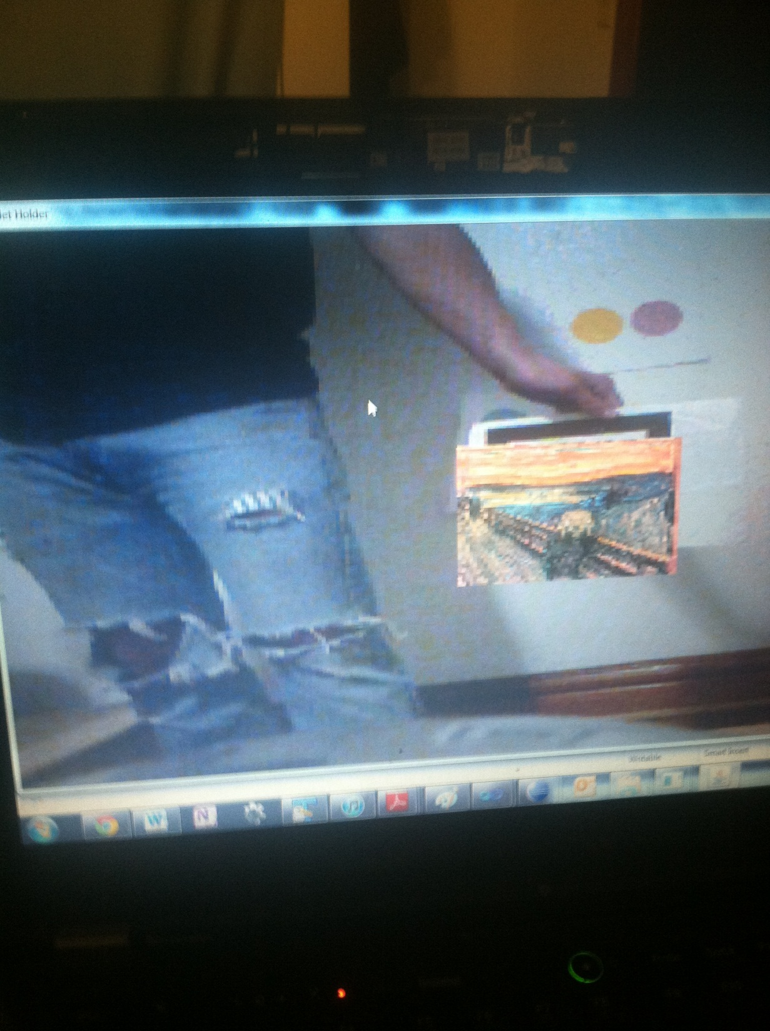
2D AR
X Y and Z translations

Slide 10
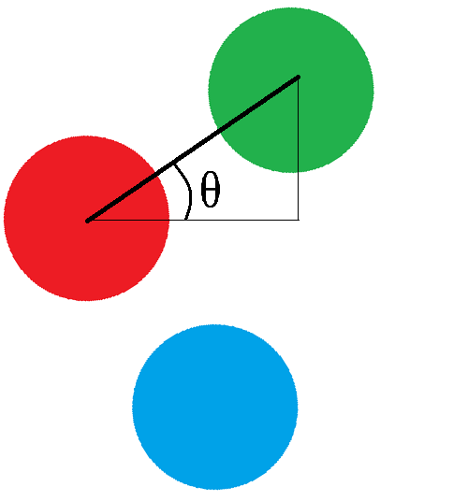
Z rotation
Array of circle objects
Hold onto their respective thresholds im
Used for Z rotation

Slide 12
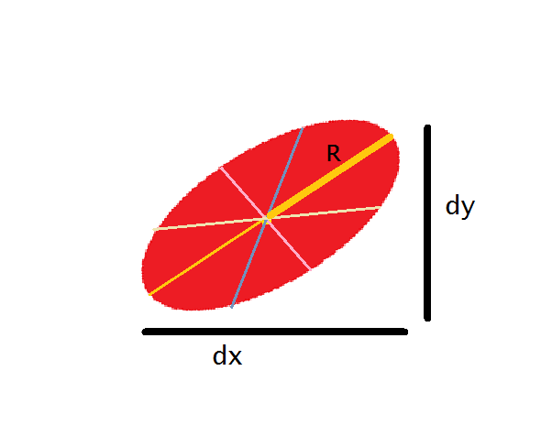
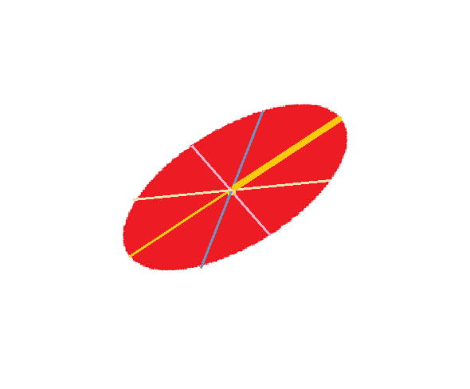
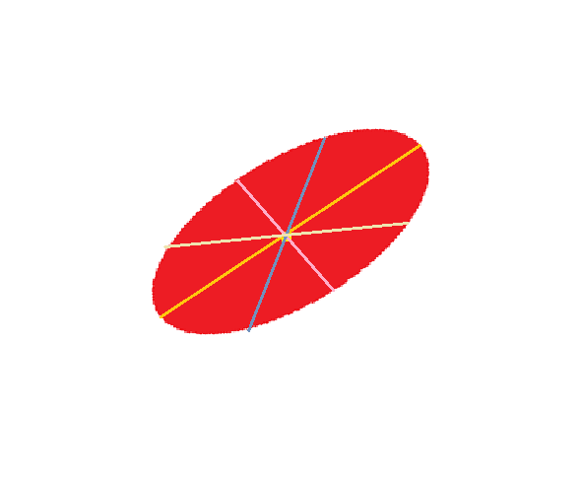

Slide 13
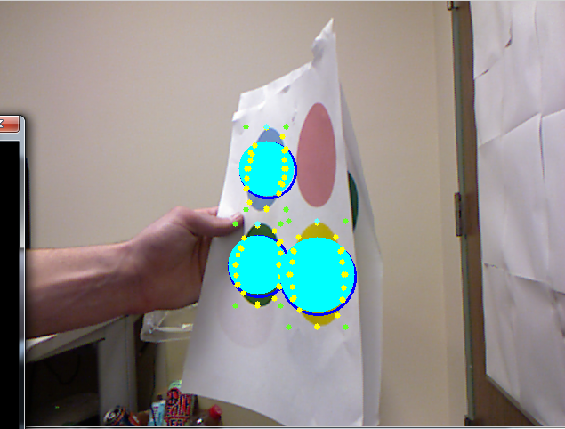
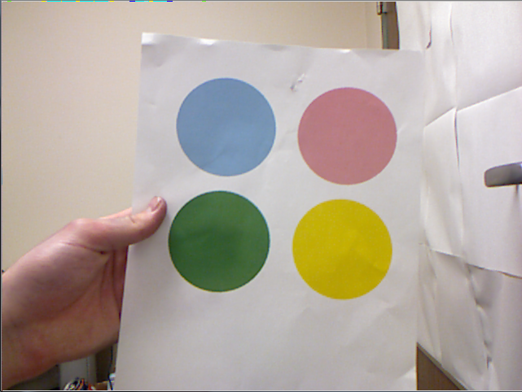
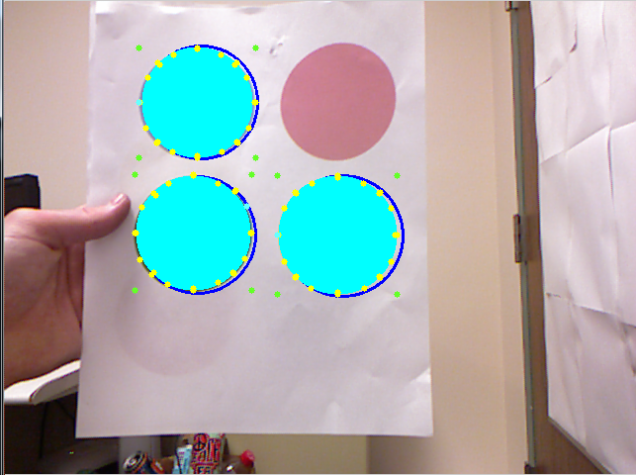

Slide 14
