Slide 1
OEM Validation Library
Nicole Ross
Real World Project for Intel

Slide 2
1.1 Introduction
Abstractable Library to use in all OEM validation Test Case’s
Attach this library to any OEM Test Case and your automation process is simplified and more organized.

Slide 3
1.2 OEM Validation History
Intel would do a set number of iterations of specific test cases
Then the wireless card would be release to OEM to do their validation.
Bugs would be found that went undetected on Intel’s side.
OEM’s would report there bugs and we would run more specific test cases on that equipment.

Slide 4
1.3 OEM Present Validation
New group at Intel Created to OEM validations and bugs.
OEM validation is done before shipping to OEM’s and bug investigation is done.
Many test cases follow a similar pattern
Same functionality needed
Create a library to use on all test cases
Save time, that is what programming is for.

Slide 5
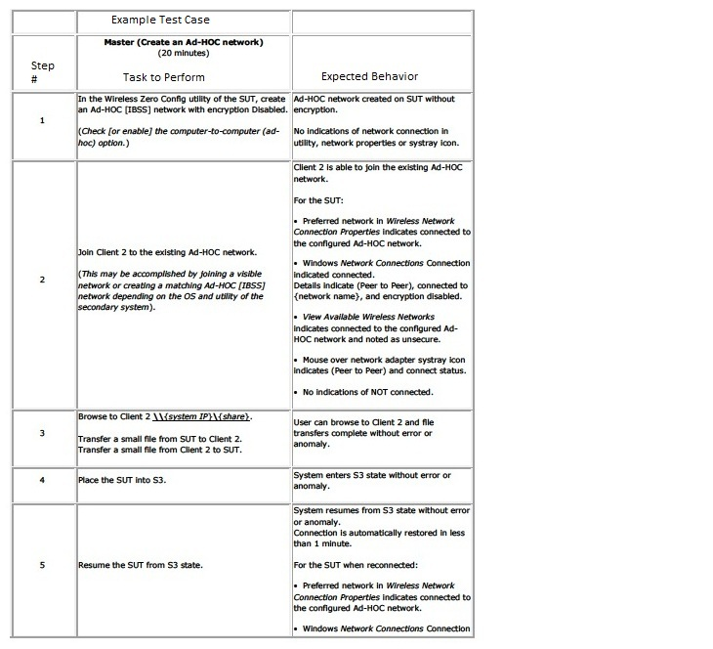
Table I: An Example OEM Test Case
Notes:
Describe
The columns
This test is made to be manual
My job is to create a set of functions to help automate
Windows Zero Configuration
S-States
New team at Intel take these manual tests and automate them and perform the tests on appropriate hardware.

Slide 6
2.0 Phase 1
2.1.1 Analysis
Figure out what library would do
Gather tools and equipment
Server
Switches
Cables
Test DUT’s (device under test)
Access Points
Power Distribution Unit
Misc. equipment to implement the lab.

Slide 7
2.1.1 Analysis Continued
Learn what ITE was: Integrated Test Environment
Set up ITE on DUT’s
Learn VB
Do test manually first.

Slide 8
2.1.2 Setup
Ghost
Setup DUT’s with same Win7 images
Create an image and load images
Images had ITE on them
Updated ITE 3 times with new releases
Set up a physical network
Adam Jacques (Batman) and John Marra
Switches, AP’s, PDU’s, Server
SVN Repository
Getting ITE to “Work” !#$~)($^

Slide 9
This was how I learned ITE

Slide 10
2.2 Phase 2
2.2.1 Design
Understand what, now How?
Use of appropriate file hierarchy
Functions in appropriate files and folders
Make functions abstractable
Made to be used in all OEM Test Cases
Developed a pattern to follow for structure in each function

Slide 11
2.2.1 Design Continued
Drew pictures to understand the relationship between functions, files, and directories in the library.
Build a skeleton first – empty files and functions.
Taking time in this phase helped reduce stress in the coding phase
More ITE stumbles!!!!!!!!!!

Slide 12
This is how ITE made me feel!

Slide 13
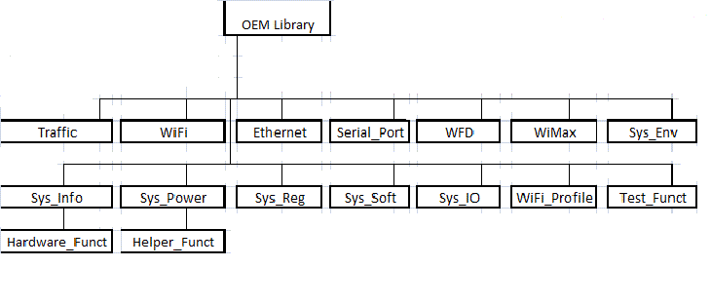
Hierarchical Design Of OEM Library

Slide 14
2.3 Phase 3
2.3.1 Coding
VB
Easy language hard to implement an API that you have little to no docs.
Code then test.
Good and bad input.
Expect good input to pass & Bad to fail.
Looks easy (not the case).
Problems and Solutions created.

Slide 15
Example Function in WiFi_Profile
Function CreateAdhocNetworkWPAAES (DUT, SSID, WPAkey)
DUT.Profile.DeleteAllProfiles()
Dim dutCreateProfile
Set dutCreateProfile = DUT.Profile.CreateProfile.WPA.Personal.AES(SSID,SSID, WPAkey, 1 ,2)
If Not dutCreateProfile.Passed Then
ITE.TestLog.Results.Error "Failed to create an Ad-Hoc Network on DUT: " & dutCreateProfile.Description
Exit Function
End If
Dim dutConnectProfile
Set dutConnectProfile = DUT.Profile.ConnectProfile(SSID)
If Not dutConnectProfile.Passed Then
ITE.TestLog.Results.Error "Failed to connect DUT to Ad-Hoc Network: " & dutConnectProfile.Description
Exit Function
End If
ITE.TestLog.Results.Pass "Successfully Created Adhoc Network with WPA/AES."
End Function.
Notes:
Go through example to show typical problems
Trouble when I created multiple functions that created profiles. -> DeleteProfiles()
Less parameters at first more later
ITE Return value is the return type
Sometimes have to strip wrapper to get a pass, fail, or description

Slide 16
2.4 Phase 4
2.4.1 Test
Test functionality after creation
Created an extra phase dedicated to testing before it was shipped.
Used good and bad parameters

Slide 17
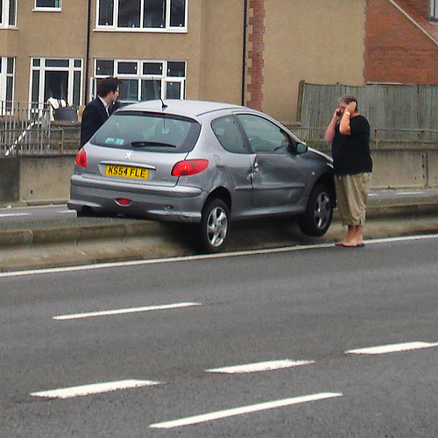
Me Testing Traffic Functions

Slide 18
2.4.2 Troubles
Iperf functions could not fail
Is “0” a valid IP?
Passes if it runs, great! (who cares if it “really” works)
Learned Wireshark to trouble shoot traffic.
Traffic was being send over Ethernet.
Created multiple functions to use for testing.
These can be used as an analysis tool.
“It's all a blur. Like a horrible day-mare.”-Robin

Slide 19
2.5 Phase 5
Release - Evaluation
And we find our selves here.
Two customers to please.
OEM Team lead was impressed.
Munir was pleased.

Slide 20
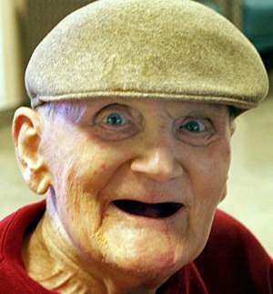
Intel’s Reaction

Slide 21
Release and Evaluation Continued
Intel is currently using it.
Lab will continue to use it and improve
Hard to improve what is already perfect
Change variable names to mirror Intel’s OEM groups automation. (doing currently)
Gear it more towards changing Test Cases
Add new technologies
BT 4.0
WiFi Direct
WiDi *** New lab on campus.

Slide 22
Considerations For The Future
May consider developing an additional library to harbor functions to help new technologies.
Another library for Analysis functions
A tool to analyze throughput
Statistical information
Get the date, report, and do something with findings.

Slide 23
Demo

Slide 24
3.0 Reason For Choosing Project
All the things I could learn
Fill some gaps that are necessary for my new position.
Enterprise Application Engineering as Performance Engineer/Analyst.
Real World Project
Customer expectations
Deadlines
Communicate success and failures

Slide 25
Reasons For Choosing Project Cont.
Truly believe in making things better.
Improve products to exceed other manufacturers.
Meet customers expectations.
Went to many meetings at Intel
Met Munir
Discussed projects, this being one

Slide 26
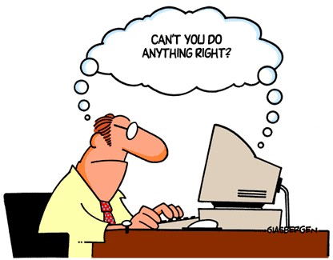
4.0 Topics Learned

Slide 27
4.0 Topics Learned Cont.
Technologies & Terminology?
Cisco OS calls
Networking protocols and terminology
Add-Hoc
Programmable switch
Iperf
Collaboration with client over want, needs, and timeline
Code under someone else's specifications
Comment under someone else's specifications
To implement Robo Doc

Slide 28
4.0 Topics Learned Cont.
VB
regExpParseString - regular expressions are not that easy in VB
Wait () to allow other functions to catch up before preceding
Switched Rack Power Distribution Unit
Wireshark packet sniffing
Code version control using SVN repository
Creating a repository on server
Comparing versions
Organizing Repo

Slide 29
How I Got Help

Slide 30
4.0 Topics Learned Cont.
Corporate Coding guidelines
Effective use of creating a timeline for a project that will continue after my departure
Utilizing abstraction layers
Validation Engineering
Building test cases from scratch
AP programming
Learning Cisco's AP system calls

Slide 31
4.0 Topics Learned Cont.
APC Switched Rack Power Distribution Unit (PDU)
How to set up from scratch
How to set up from a previous installation (much harder)
Local configuration as opposed to networked configuration
Read a lot of the user guide for command line interface
Needed to learn how to send command line commands to the PDU using telnet through Another program

Slide 32
5.0 Conclusion
Very happy with project
Topics learned
Progress made
Would have liked more hand-on
Focus on wrappers and abstraction dev.
Communication

Slide 33
Short Clip For My Viewing Pleasure

Slide 34
How I Feel NOW!

